Slide 1
Personal Presentation
Nicole Viviana Parra Cortés Aprendiz
Claudia Lorena Conde Urueña
Instructor
Centro Agroempresarial y Desarrollo Agropecuario del Huila
Análisis y Desarrollo de Software SENA

Slide 2
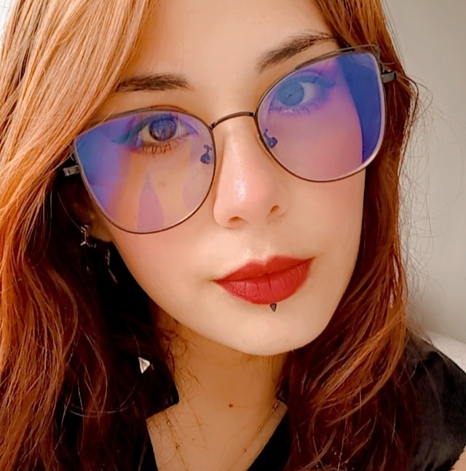

My name is Nicole Parra
I´m 23 years old

Slide 3
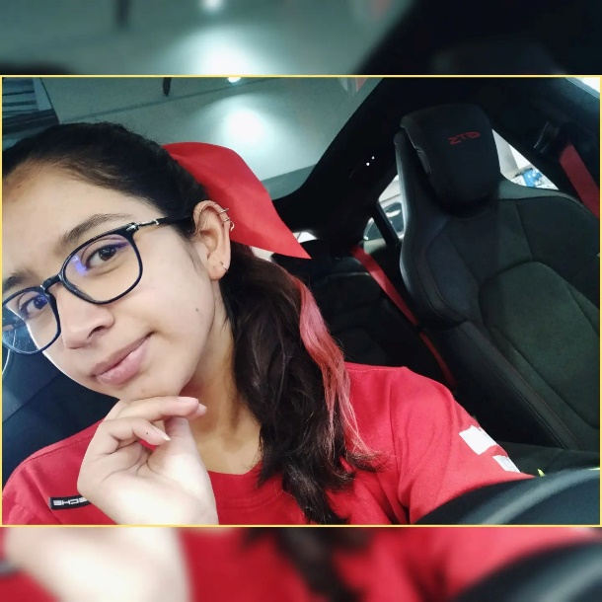
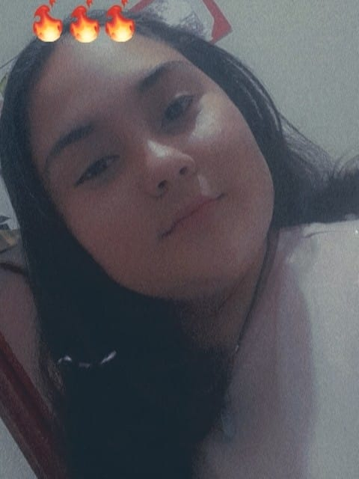
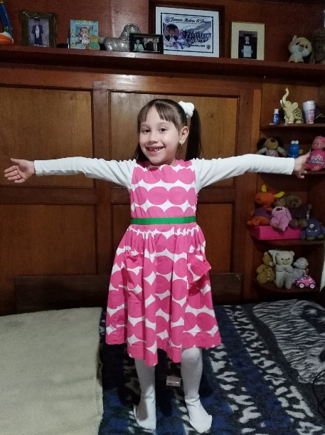
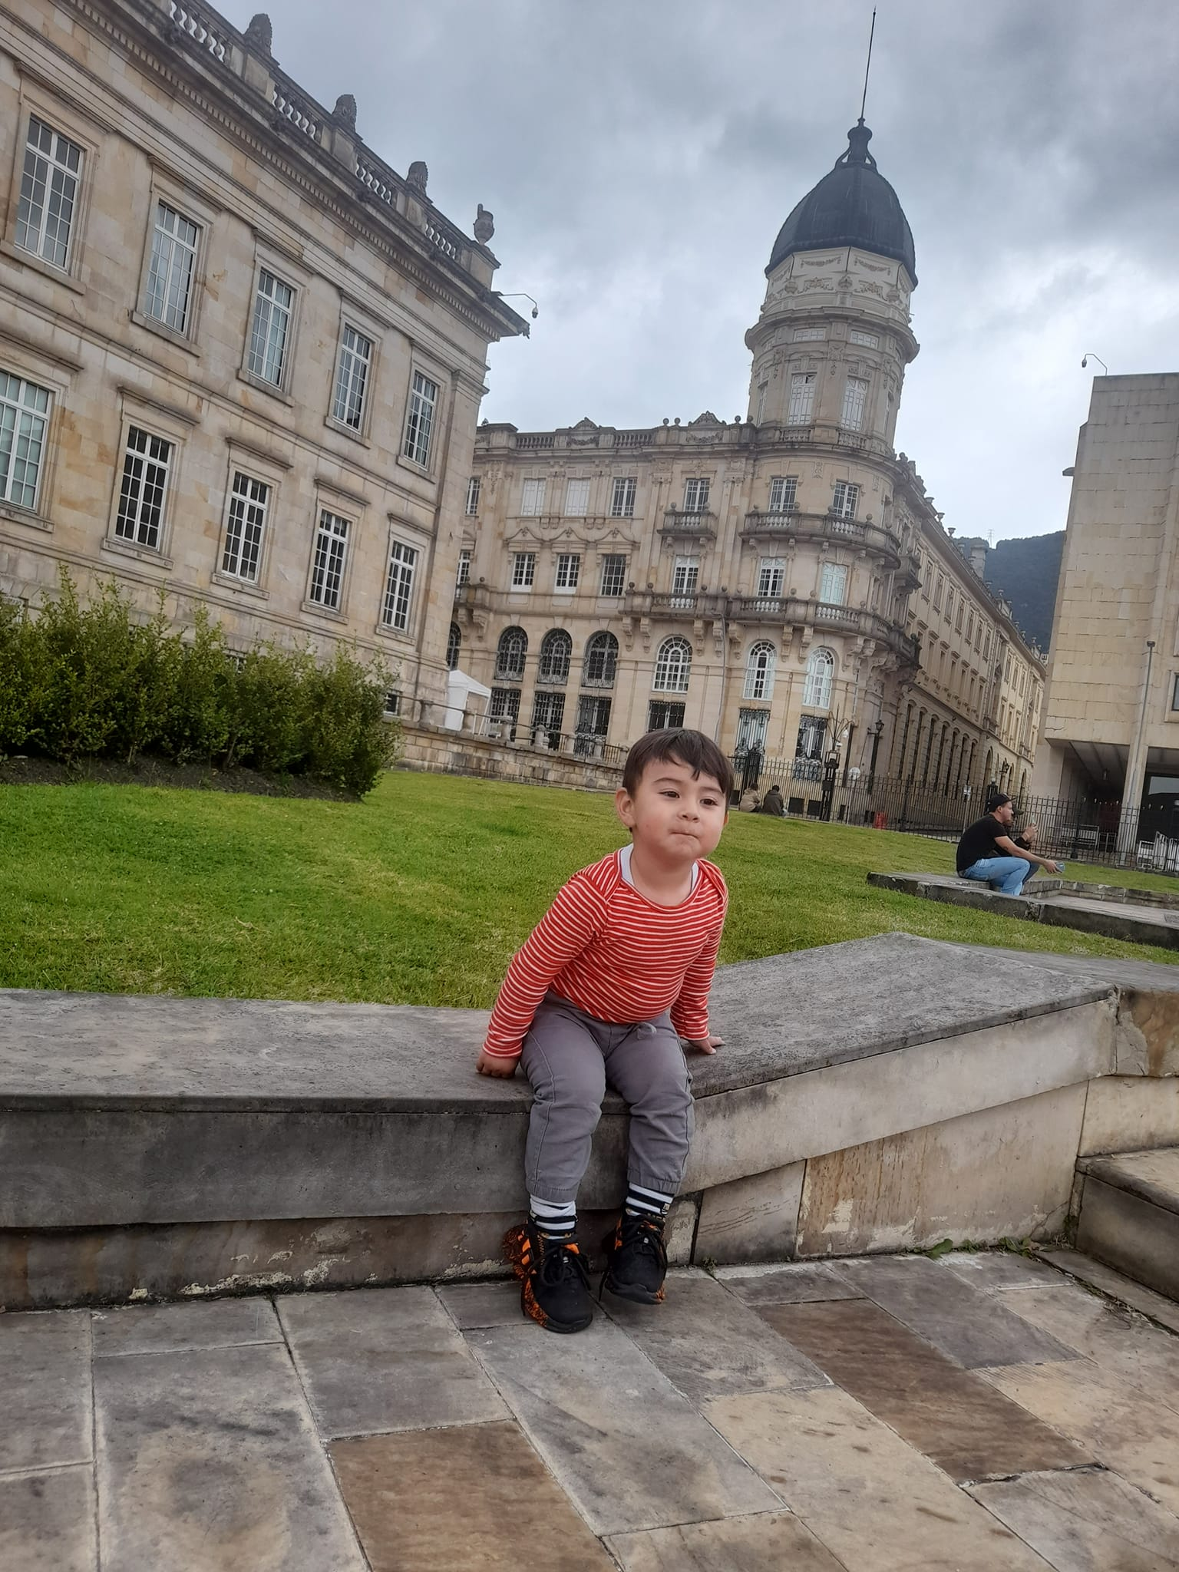
Laura Sofia Thaliana Felipe
I have a 3 sisters and 1 brother

Slide 4
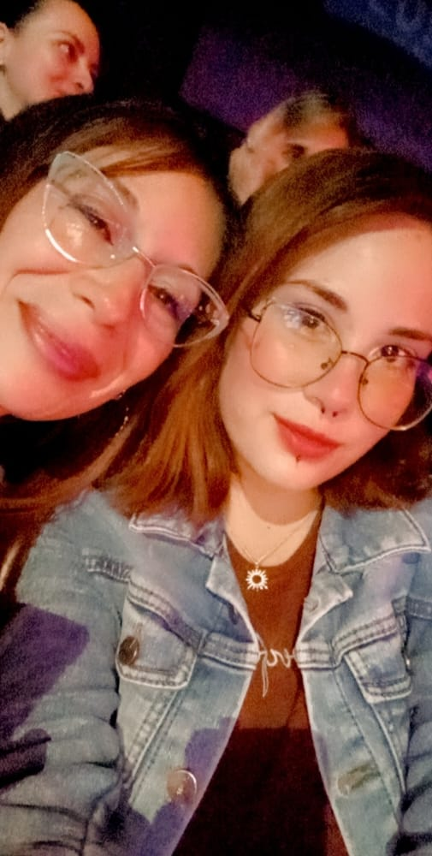
I live with my mom

Slide 5
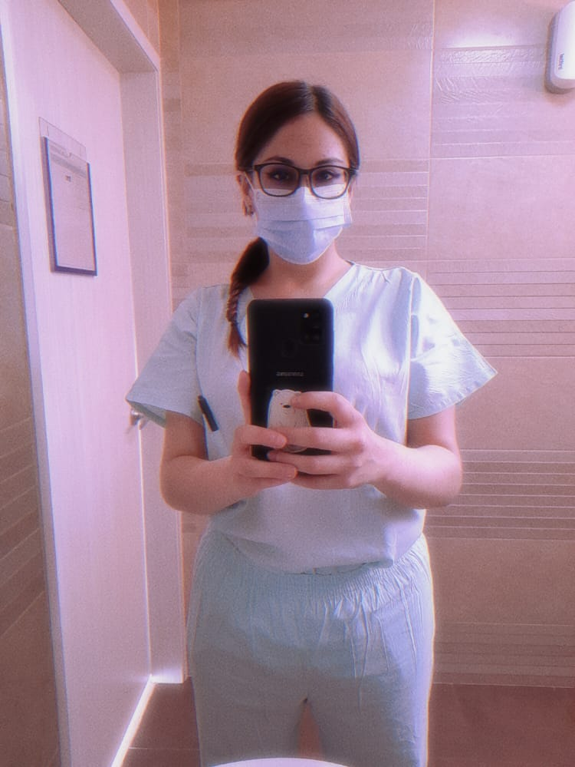
I´m a mental health nursing assistant

Slide 6
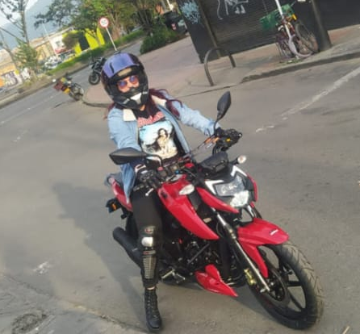
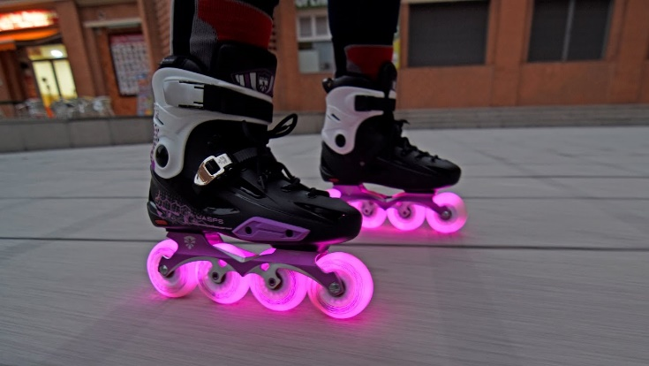
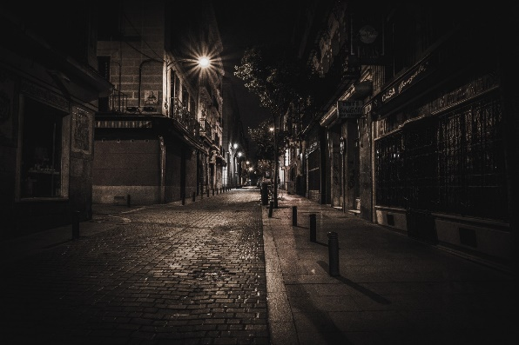

My hobbies are going out to skate, listening to music, mainly I really like rock and metal from all eras, I like other genres, except corridos and northern music, my favorite band is Guns N' Roses, I like to walk in the night, I have a motorcycle. so I go out to see various places.

Slide 7
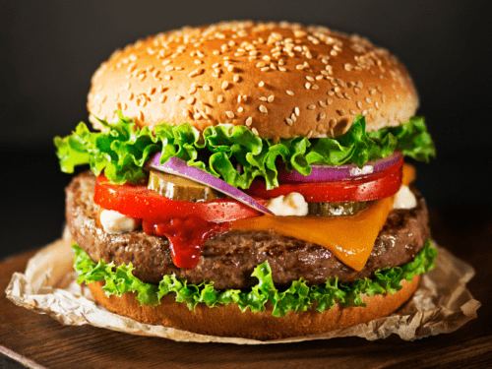
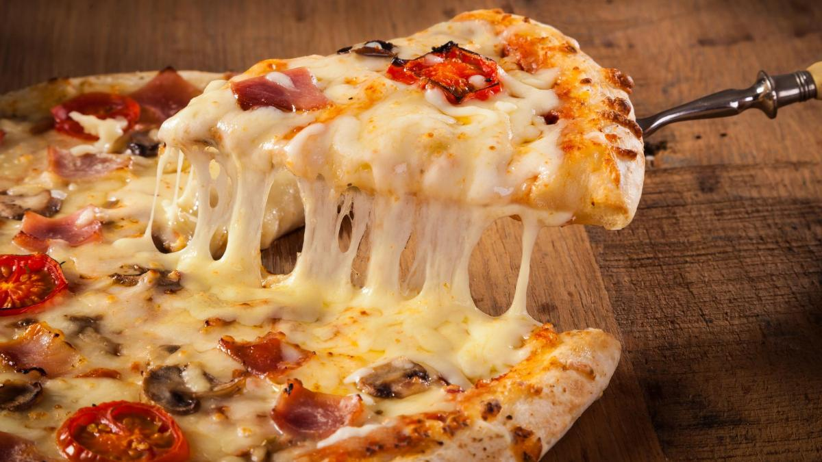
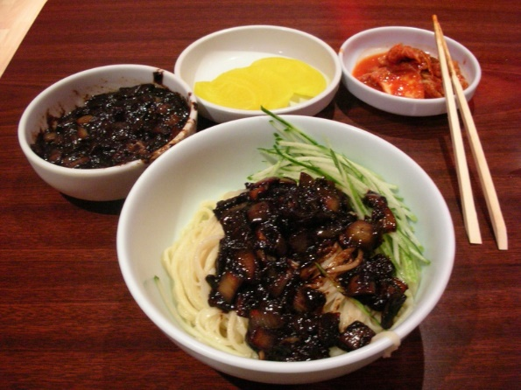

My favorite food is hamburger and pizza. I also really like Asian food and soju is Korean brandy.

Slide 8
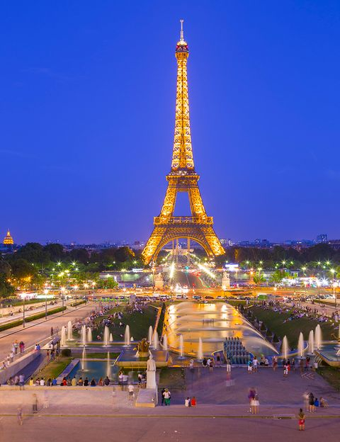



My dream is in about 10 years to have been able to travel all over the world and have graduated as a software engineer.

Slide 9
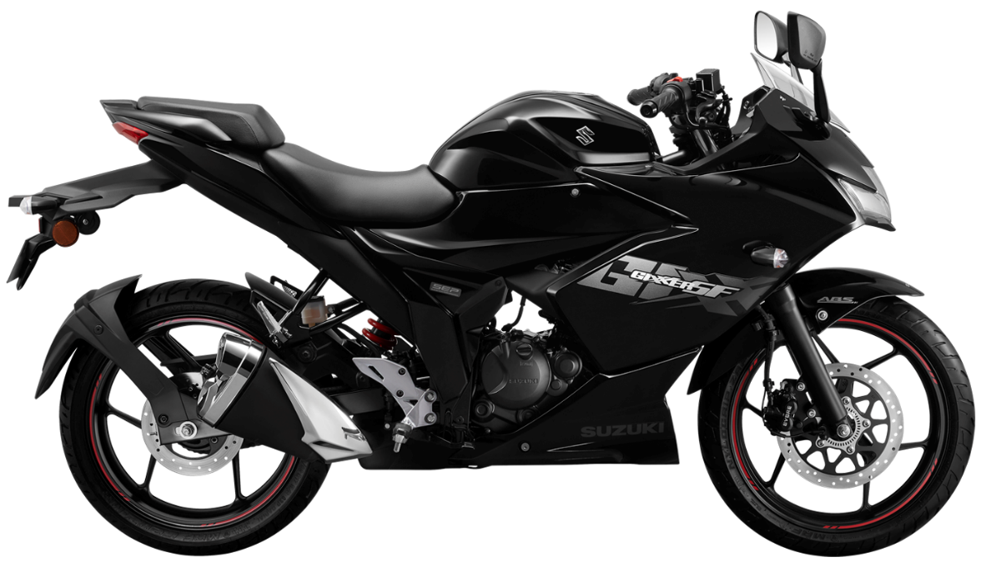
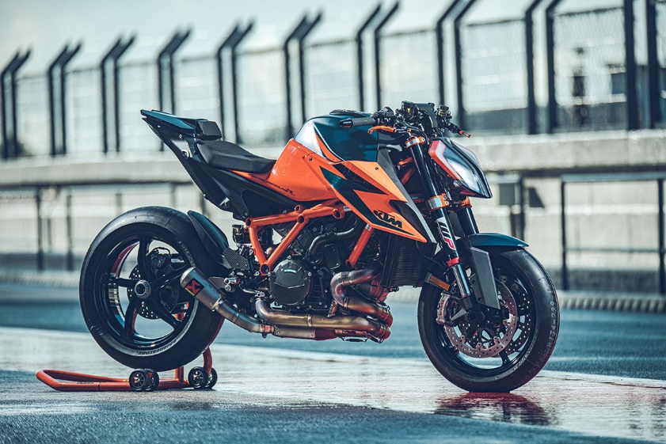
Having the bike of my dreams, which is a Superduke one thousand two ninety r, although if I can have a gixxer two fifty sport, I'll settle for that.

Slide 10

I hope my colleagues like me and learn a lot from this program.
THANKS

